Slide 1
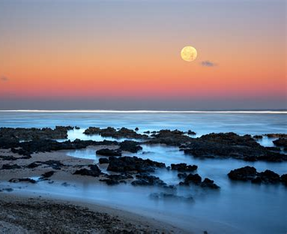
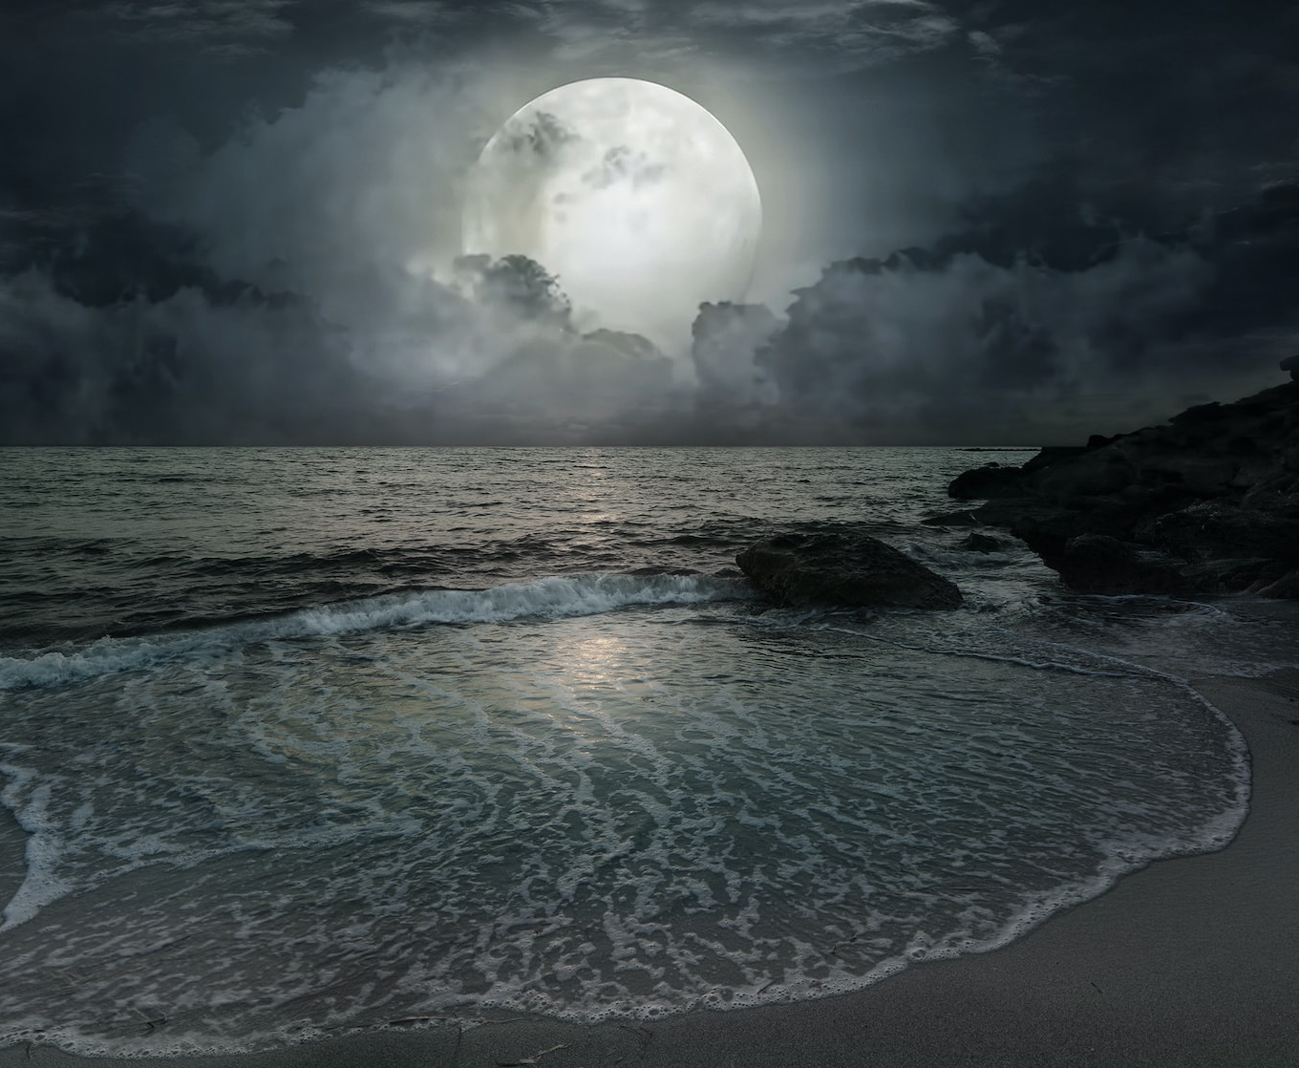
Tides – Page 1
Hey there, super learners! Did you ever look at the moon and wonder what it's doing? Well, the moon isn’t just hanging around for fun. It's got a big job! It controls something magical called “tides” in our giant oceans. Just picture the ocean waves giving a little “hello” and then a “goodbye”. This is because our buddy, the moon, acts like a magnet. It pulls ocean water close, like a big hug, and then lets it dance away. Yes, it's like the moon and the water are dancing together!
What important job does the moon have? ___________________________________________________________________
What are “tides”? ___________________________________________________________________
Who controls the tides in our oceans? ___________________________________________________________________
Let's dive into our imaginations for a second. Picture yourself holding a super-duper strong magnet. Move it near some metal toys, and voila! They race towards it, right? Now, our shiny moon does something kinda similar. Even though it’s way up in the sky, it has this power to tug our vast ocean waters closer. This magical pull creates what's known as “high tide”. But when the moon decides it needs a break, maybe a moon nap, the waters retreat, giving us “low tide”.
What are we pretending to have? ___________________________________________________________________
How is the moon similar to a magnet? ___________________________________________________________________
What do we call it when the moon pulls the ocean water towards it? ___________________________________________________________________

Slide 2
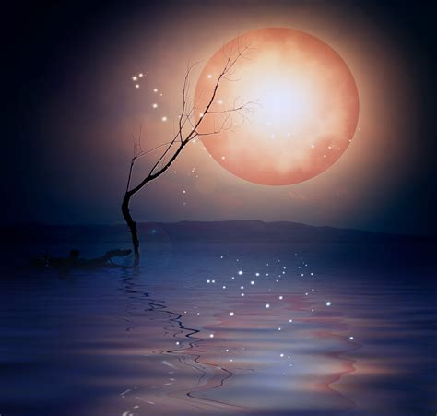
Tides – Page 2
Ready for another sprinkle of moon magic? Our mysterious moon doesn’t just have a say with the oceans. It slightly tickles giant lakes and, believe it or not, even us! If our moon can play tug-of-war with massive oceans, think about its gentle pull on a glass of water. Now, a little secret – the moon promises not to knock over your juice! It's a tiny force, but pretty awesome. When we think about it, the moon is like Earth's magical puppeteer, isn’t it?
Does the moon only affect the oceans? __________________________________________________________________
Can the moon pull a glass of water? __________________________________________________________________
Will the moon spill your drink? __________________________________________________________________
Now that you’ve learned about the moon and tides, can you come up with a fun story or draw a picture showing how the moon controls tides? Use your imagination! Maybe the moon has hands, or perhaps the ocean waves are dancing! Get creative and share your masterpiece with the class.

